Slide 1

¡Bienvenidos a nuestra lección de español!
Hola everybody! Welcome to our Spanish lesson!
Let’s start with our Buenos Días song in slide 2. Sing along!
If you can’t open the link, try to find it on YouTube: https://www.youtube.com/watch?v=IRXeDfxcjjc

Slide 2


Slide 3
La lección para esta semana. Lesson for this week!
This week’s Spanish lesson will be new for some children and a recap for others. We are going to learn how to say, “When is your birthday?” and reply with “My birthday is on the (number) of (month)
Use the power point in slide show mode .Slide number 4 shows you how to say “When is your birthday?” and “My birthday is on the (number) of (month) I’ve used my birthday as an example.
Once you’ve gone over the lesson ,you could perhaps teach somebody that you live with!
¡Buena Suerte! Good Luck!

Slide 4
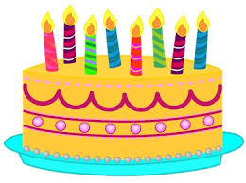
¿Cuándo es tu cumpleaños?
Mi cumpleaños es el 27 de julio

Slide 5

Instructions for slide number 6
Use the power point in slide show mode .
Grab a pen and piece of paper and try to change the sentences from Spanish into English.

Slide 6
¿Cuándo es tu cumpleaños?
Mi cumpleaños es el tres de marzo.
My birthday is on the 3rd of March.
Mi cumpleaños es el dieciocho de enero.
My birthday is on the 18th of January.
Mi cumpleaños es el once de junio.
My birthday is on the 11th of June.
The first is PRIMERO.
4. Mi cumpleaños es el primero de diciembre.
My birthday is on the 1st of December.

Slide 7
Instructions for slide number 8
Use the power point in slide show mode .
Using your pen and piece of paper try to change the sentences from English into Spanish. This is much harder, so you can look back on slide 6 to help you.

Slide 8
¿Cuándo es tu cumpleaños?
Mi cumpleaños es el veinticuatro de abril.
My birthday is on the 24th of April.
Mi cumpleaños es el quince de febrero.
My birthday is on the 15th of February.
Mi cumpleaños es el treinta y uno de noviembre.
My birthday is on the 31st of November.
Mi cumpleaños es el cinco de octubre.
My birthday is on the 5th of October.

Slide 9

Instructions for slide number 10- Take a break!
It’s our birthday song in Spanish! Listen to it and try to join in with the actions!
If you can’t open the link, try to find it on YouTube: https://www.youtube.com/watch?v=hwpdDCKITT8
Yes, even you, Y5!

Slide 10
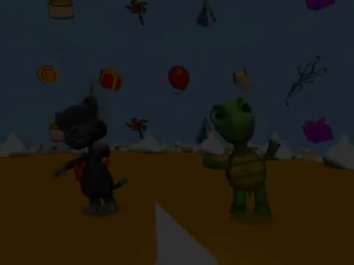

Slide 11
Instructions for the activity sheet
It’s time for the activity sheet. You may have already done this activity sheet, but you can do it again, and keep this one at home. If you can, print it off, you just need to fill in the date of your birthday and the month of your birthday. Don’t forget to write the date in Spanish at the top. Use slides 12, 13 and 14 to help you.
When you’ve finished , write out the whole sentence in Spanish on the lines below.
When you’ve done all the writing, you can colour in the activity sheet.

Slide 12
Activity Sheet Help
When you are writing the date, choose the correct day and month:
lunes
martes
miércoles
jueves
viernes
sábado
domingo
Remember:DAYS OF THE WEEK AND MONTHS OF THE YEAR DO NOT START WITH CAPITALS IN SPANISH!!!!!!
enero
febrero
marzo
abril
mayo
junio
julio
agosto
septiembre
octubre
noviembre
diciembre

Slide 13
Activity Sheet Help
Uno = 1
Dos =2
Tres =3
Cuatro =4
Cinco =5
Seis =6
Siete =7
Ocho =8
Nueve =9
Diez =10
Once =11
Doce =12
Trece =13
Catorce =14
Quince =15
Dieciséis =16
Diecisiete =17
Dieciocho =18
Diecinueve =19
Veinte =20
Veintiuno =21
Veintidós =22
Veintitrés =23
Veinticuatro =24
Veinticinco =25
Veintiséis =26
Veintisiete =27
Veintiocho =28
Veintinueve =29
Treinta =30
Treinta y uno =31

Slide 14
¿Cuándo es tu cumpleaños?
Mi cumpleaños es el (number) de (month)

Slide 15

¡Hasta la próxima lección!
See you soon for the next lesson!
¡Cuidaos! – Take Care!
Señora Interian

