Slide 1

¡Bienvenidos a nuestra lección de español!
Hola everybody! Welcome to our Spanish lesson!
Let’s start with our Buenos Días song in slide 2. Sing along!
If you can’t open the link, try to find it on YouTube: https://www.youtube.com/watch?v=IRXeDfxcjjc

Slide 2


Slide 3
La lección para esta semana. Lesson for this week!
This week’s Spanish lesson is all about learning how to say the colour of hair. Use the power point in slide show mode. Slide number 4 introduces the lesson; “Retratos”
Slides 5-14 teach you how to say different colours of hair; I have blond hair, I have black hair, I have brown hair, I have grey hair, and I have red hair. You might recognise the faces, if you play Guess who?
There is help with the sounds of the words. Do this a few times, until you are confident, that you know them.
You could perhaps learn with somebody that you live with and compete with each other to see who can learn them the quickest!
¡Buena Suerte! Good Luck!
© 22.06.20 L. Interian

Slide 4
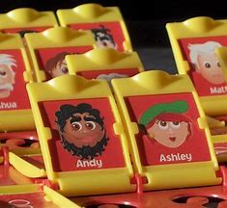
Retratos - Portraits

Slide 5
It’s important to remember …
In English, the adjective comes before the noun, but in Spanish, the adjective comes after the noun.
Example
English = blond hair
blond = adjective
hair = noun
Can you work out the order in Spanish, before you look at the next slide?

Slide 6
Hair blond

Slide 7
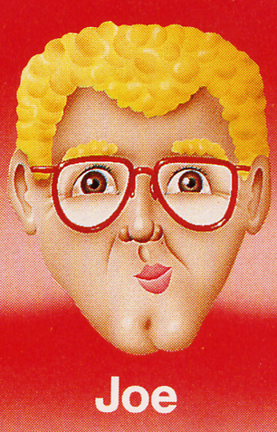
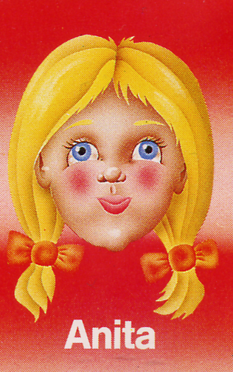
Tengo (I have) el pelo rubio ten-go el pay-lo roo-bee-oh

Slide 8
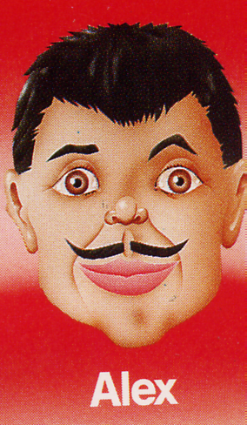
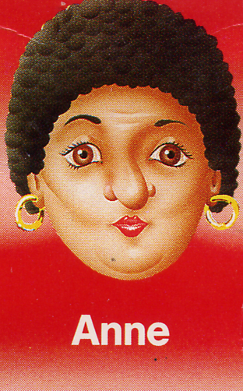
Tengo el pelo negro ten-go el pay-lo neg-row

Slide 9
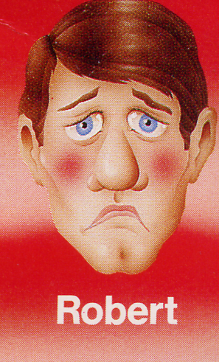
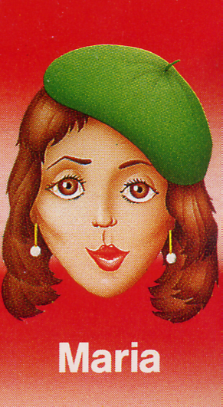
Tengo el pelo castaño ten-go el pay-lo cast-an-yo

Slide 10
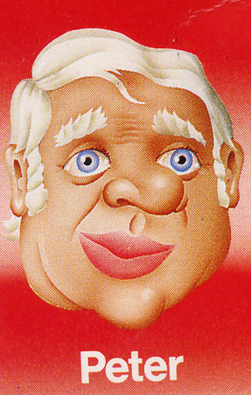
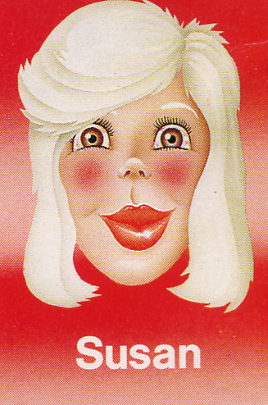
Tengo el pelo gris ten-go el pay-lo grees

Slide 11


Can you spot the change for Alfred and Claire in the next two slides?
For people with red hair, we say; I am red haired.
A bit confusing, I know!
Also, there is a different word for red haired if you are a male or female. Can you spot the differences?

Slide 12
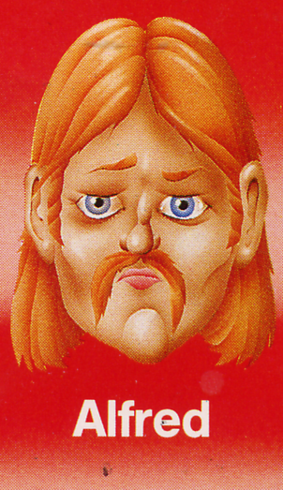
Soy pelirrojo soy peli-ro-ho

Slide 13
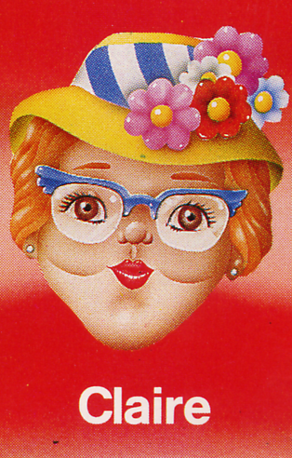
Soy pelirroja soy peli-ro-ha

Slide 14
Did you spot the difference?
Pelirrojo is used for males (men and boys)
Pelirroja is used for females ( women and girls)
Soy pelirrojo
Soy pelirroja
© 22.06.20 L. Interian

Slide 15

Instructions for slides 16 & 17
Use the power point in slide show mode .
Grab a pen and piece of paper.
Can you guess what the sentences mean?
The answers are on slide 17.
© 22.06.20 L. Interian

Slide 16
Tengo el pelo rubio
Tengo el pelo negro
Tengo el pelo castaño
Soy pelirrojo
Soy pelirroja
Tengo el pelo gris

Slide 17
I have blond hair
I have black hair
I have brown hair
I have red hair (boy)
I have red hair (girl)
I have grey hair

Slide 18
Instructions for slides 19 - 21
You have to look at the pictures of the people on slide 19.
Read the sentences on slide 20, and try to work out which hair description belongs to which person.
The answers are on slide 21.
© 22.06.20 L. Interian

Slide 19
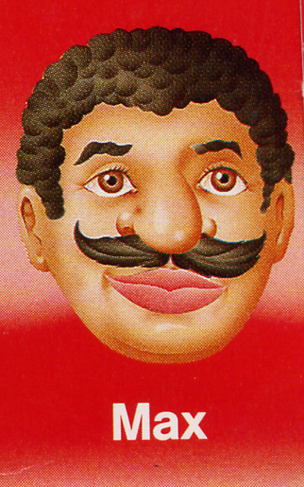
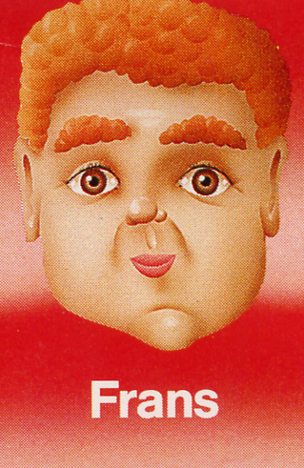
¿Quién es?

Slide 20

¿Quién es?
Tengo el pelo rubio =
Tengo el pelo gris =
Tengo el pelo castaño =
Soy pelirroja =
Tengo el pelo negro =
Soy pelirrojo =

Slide 21
¿Quién es?
Tengo el pelo rubio = Anita
Tengo el pelo gris = Susan
Tengo el pelo castaño = Maria
Soy pelirroja = Claire
Tengo el pelo negro = Max
Soy pelirrojo = Frans

Slide 22
Instructions for slides 22 & 23
Can you unjumble the hair colour written in red on the next slide?
The answers are on slide 24.
© 22.06.20 L. Interian

Slide 23
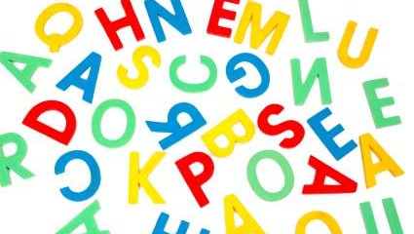
Unjumble - Ordenar
Tengo el pelo buoir
Tengo el pelo stacaoñ
Tengo el pelo rogne
Tengo el pelo srig
Soy rrjoelpio
Soy rrjaelpio

Slide 24
Unjumble - Ordenar
Tengo el pelo buoir = rubio
Tengo el pelo stacaoñ =castaño
Tengo el pelo rogne = negro
Tengo el pelo srig = gris
Soy rrjoelpio = pelirrojo
Soy rrjaelpio = pelirroja

Slide 25
With this activity sheet, you need to look at the sentences below the faces. Read the sentence, and colour the hair in the correct colour.
Then, write a sentence in Spanish to describe your hair colour. Use slides 7 to 9 to help you.
Don’t forget to write the date in Spanish at the top. Use slide 26 to help you.
© 22.06.20 L. Interian

Slide 26
Activity Sheet Help
When you are writing the date, choose the correct day and month:
lunes
martes
miércoles
jueves
viernes
sábado
domingo
Remember:DAYS OF THE WEEK AND MONTHS OF THE YEAR DO NOT START WITH CAPITALS IN SPANISH!!!!!!
enero
febrero
marzo
abril
mayo
junio
julio
agosto
septiembre
octubre
noviembre
diciembre
© 22.06.20 L. Interian

Slide 27

¡Hasta la próxima lección! See you soon for the next lesson! ¡Cuidaos! – Take Care! Señora Interian © 22.06.20 L. Interian

