Slide 1

¡Bienvenidos a nuestra lección de español!
Hola everybody! Welcome to our Spanish lesson!
Let’s start with our Buenos Días song in slide 2. Sing along!
If you can’t open the link, try to find it on YouTube: https://www.youtube.com/watch?v=IRXeDfxcjjc

Slide 3

La lección para esta semana. Lesson for this week!
This week’s Spanish lesson is all about “Los Colores” (the colours) in Spanish.
Use the lesson to see how much you can remember? It should be easy!
Use the power point in slide show mode .Slide number 4 introduces the lesson ;”Los Colores”
Slides 5 - 8 teach you the colours. I have put the sounds of the words in brackets, so you can practise how to say them. Do this a few times, until you are confident that you know them.
You could perhaps learn with somebody that you live with and compete with each other to see who can learn them the quickest!
¡Buena Suerte! Good Luck!

Slide 4
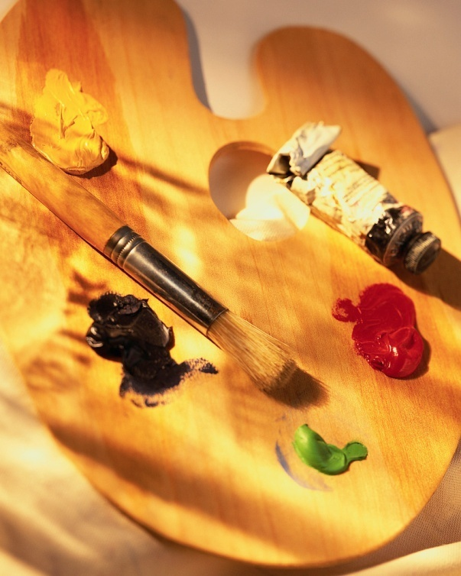
Los Colores
The colours

Slide 5
rojo
The ‘j’ makes a ‘h’ sound
azul
The ‘z’ makes a ‘th’ sound
amarillo
The ‘ll’ makes an ‘ee’ sound

Slide 6
naranja
The ‘j’ makes a ‘h’ sound
gris
Emphasise the ‘i’ which makes an ‘ee’ sound

Slide 7
verde
Morado/violeta
The v is a ‘b’ sound
rosa - rohsa
Marrón Don’t forget to raise your voice on the ó

Slide 8
blanco
negro
The c makes a ‘k’ sound

Slide 9

Instructions for slides 10-11
Use the power point in slide show mode .
Grab a pen and piece of paper.
This exercise will help you to practise the spellings of the colours.
Write down the missing vowel.(a,e,i,o,u)
The answers are on slides 13 & 14.
© 19.06.20 L. Interian

Slide 10
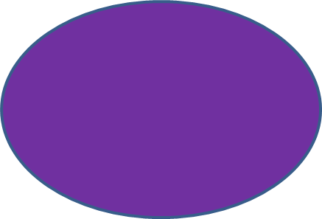
R-j-
N-r-nj-
-z-l
V-rd-
R-s-
-m-r-ll-
M-r-d-/v- -l –t -

Slide 11
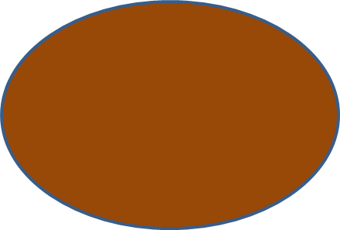
Name the colour!
Bl-nc-
N-gr-
M-rr-n
Gr-s

Slide 12
Instructions for slides 13-14
These are the answers to slides 10 and 11.
If you didn’t get them all right, try doing them again, until you are confident of the spellings.
© 19.06.20 L. Interian

Slide 13
Respuestas - Answers
rojo
naranja
azul
verde
rosa
amarillo
Morado/violeta

Slide 14
Respuestas - Answers
Blanco
Negro
Marrón
Gris

Slide 15
Instructions for slide number 16 - Take a break!
It’s a rainbow song! The song is in both Spanish and English.
If you can’t open the link, try to find it on YouTube:
https://www.youtube.com/watch?v=aaQrsdnGB48

Slide 16


Slide 17
Instructions for slide 18 & 19
Use the power point in slide show mode.
The game won’t work if you don’t.
The colours will disappear one at a time, and you have to write the colour that disappears on the ¿Qué color falta? sheet.
I have done both a black and white and a colour version of the ¿Qué color falta? sheet.
The answers are on slide 19.

Slide 18
¿Qué color falta? Name the missing colour

Slide 19


¿Qué color falta? Answers
Missing colour 1 = amarillo
Missing colour 2 = rojo
Missing colour 3 = rosa
Missing colour 4 = gris
Missing colour 5 = naranja
Missing colour 6 = azul
Missing colour 7 = negro
Missing colour 8 = marrón
Missing colour 9 = blanco
Missing colour 10 = verde
Missing colour 11 = morado or violeta
© 19.06.20 L. Interian

Slide 20
Instructions for slides 21- 26
It’s time for the activity sheet.
I have given you 2 choices of activity sheet, so choose the one that you suits you the best.
If you want to do both, you can!
© 19.06.20 L. Interian

Slide 21

Fecha: _______________________________________________
El Arco Iris
With this activity sheet, you need to look at the colours below the rainbow. Colour in the first colour at the top of the rainbow, and work your way down.
Don’t forget to write the date in Spanish at the top.
Use slides 22 & 23 to help you.
Colorear el arco iris en este orden de arriba hasta abajo:
Top of the rainbow - Rojo
Amarillo
Rosa
Verde
Naranja
Morado
Bottom of rainbow -Azul
© 19.06.20 L. Interian

Slide 22
Activity Sheet Help
When you are writing the date, choose the correct day and month:
lunes
martes
miércoles
jueves
viernes
sábado
domingo
Remember:DAYS OF THE WEEK AND MONTHS OF THE YEAR DO NOT START WITH CAPITALS IN SPANISH!!!!!!
enero
febrero
marzo
abril
mayo
junio
julio
agosto
septiembre
octubre
noviembre
diciembre
© 19.06.20 L. Interian

Slide 23
Activity Sheet Help
(Rainbow)
These are the missing
words, but watch out!
They aren’t in order:
Morado
Verde
Naranja
Rojo
Amarillo
Azul
Rosa
© 19.06.20 L. Interian
© 17.04.20 L. Interian

Slide 24








Fecha: _______________________________________________
With this activity sheet, you need to look at the colours below the circles, and colour them in using the correct colour.
I’ve given you a clue to the first 4 colours. Can you spot the clue?
Don’t forget to write the date in Spanish at the top.
Use slides 25 & 26 to help you.
Los Colores
© 19.06.20 L. Interian

Slide 25
Activity Sheet Help
When you are writing the date, choose the correct day and month:
lunes
martes
miércoles
jueves
viernes
sábado
domingo
Remember:DAYS OF THE WEEK AND MONTHS OF THE YEAR DO NOT START WITH CAPITALS IN SPANISH!!!!!!
enero
febrero
marzo
abril
mayo
junio
julio
agosto
septiembre
octubre
noviembre
diciembre
© 19.06.20 L. Interian

Slide 26
Activity Sheet Help
(Circles)
These are the missing
words, but watch out!
They aren’t in order:
Morado
Verde
Naranja
Rojo
Amarillo
Marrón
Negro
Azul
Blanco
Rosa
© 19.06.20 L. Interian
© 17.04.20 L. Interian

Slide 27

¡Hasta la próxima lección!
See you soon for the next lesson!
¡Cuidaos! – Take Care!
Señora Interian
© 19.06.20 L. Interian

