Slide 1

¡Bienvenidos a nuestra lección de español!
Hola Y6 and welcome to our Spanish lesson!
Don’t forget to use “Linguascope” to help you go over/learn new vocabulary (words)
The next slide will show you how to log on to Linguascope.

Slide 2

Linguascope log on
Search for https://www.linguascope.com
Click on Log in
Username = stcats
Password = langs4life
Click on Let’s go
Click on Beginner
Click on Yellow and red flag
Click on one of the new topics, or go over a topic that we have already learnt. All of the topics are very useful for High School, so just choose the ones you are interested in.
Click on Introducción & then practise the words.
Click on ¡Escucha! and do this exercise to see if you’re ready for the games.
Play the games.
If you have a printer at home, you could print the worksheet by clicking on Imprime una ficha.

Slide 3
La lección para esta semana. Lesson for this week!
In this week’s Spanish lesson, we are going to learn how to conjugate (form) the present tense of regular IR verbs.
As with AR and Er verbs we need to know the subject pronouns to help us form the present tense.
Before we start to learn how to conjugate (form) the present tense of IR verbs, we are going to do some revision of the last three lessons.
Don’t forget to use the power point in slide show mode. The lesson will work better that way.

Slide 4
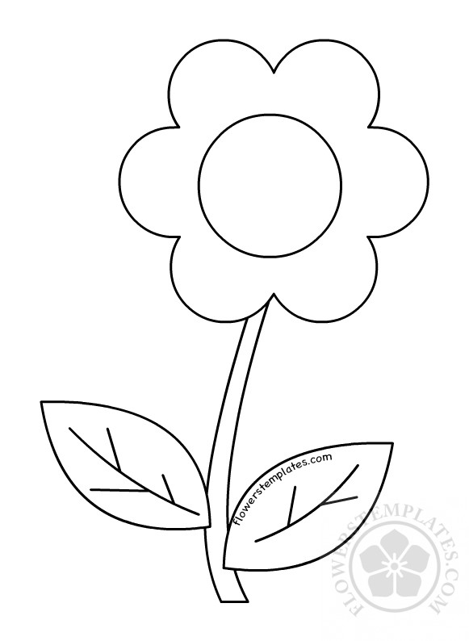
Empareja – Match up
6
1
5
2
Can you conjugate (form) the verb “HABLAR” in the present tense?
The parts of the verb are below, but they aren’t in the correct order. Can you put them in the correct petal?The answers are on the next slide.
4
3
hablan
hablamos
hablO
habla
hablas
habláis

Slide 5

Respuestas – Answers
hablan
hablO
habláis
hablas
hablamos
habla

Slide 6
Empareja – Match up
6
1
5
2
Can you conjugate (form) the verb “COMER” in the present tense?
The parts of the verb are below, but they aren’t in the correct order. Can you put them in the correct petal? The answers are on the next slide.
4
3
comen
comemos
comO
come
comes
coméis

Slide 7
Respuestas – Answers
comen
comO
coméis
comes
comemos
come

Slide 8
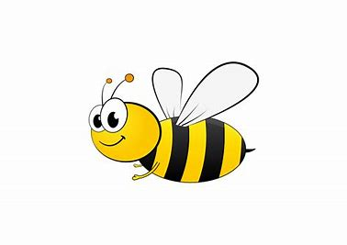

Subject Pronouns
ELLOS
ELLAS
YO
VOSOTROS
VOSOTRAS
TÚ
Bee- come a person
Can you match up the English subject pronouns to the Spanish ones in the petals? The answers are on the next slide.
They
I
We
He/She
You (singular)
You (plural)
NOSOTROS
NOSOTRAS
ÉL/ELLA

Slide 9
Subject Pronouns
They
ELLOS
ELLAS
YO
I
You (singular)
VOSOTROS
VOSOTRAS
TÚ
You (plural)
Respuestas - Answers
We
He/She
NOSOTROS
NOSOTRAS
ÉL/ELLA

Slide 10

Today… We are going to learn how to conjugate (form) the present tense of an IR verb in Spanish ?
Using a pen and paper, go through each of the steps and make notes. It’s important to make notes or you will get lost!
Let’s imagine a flower again ..

Slide 11
Step 1
VIVIR
Take the infinitive (the whole verb))
VIVIR (to live)

Slide 12
Step 2
Cut off the ir to get the stem VIV…
VIV

Slide 13
Step 3
ELLOS
ELLAS
YO
VOSOTROS
VOSOTRAS
TÚ
Bee- come a person
(here, you have to remember the subject pronouns, so you know which person the verb is referring to)
NOSOTROS
NOSOTRAS
ÉL/ELLA
VIV

Slide 14
Step 4
en
O
ís
es
Add these endings to the stem, viv.
imos
e
VIV

Slide 15
Step 5
viven
vivO
vivís
vives
You have conjugated (formed) the verb “VIVIR” in the present tense!
Repeat those steps, until you think you’ve got a good idea of how to follow them.
vivimos
vive

Slide 16


Now try it on your own!
© 10.06.20 L. Interian

Slide 17

Vivir
To live
What is the stem?

Slide 18

The stem is VIV

Slide 19
What are the endings?

Slide 20
The endings are …
O
ES
IMOS
ÍS
EN
E

Slide 21
What does the verb look like when it’s all conjugated (formed) ?

Slide 22
Vivir = To live
vivo I live
vives you (singular) live
vive he/she/it/lives
vivimos we live
vivís you (plural) live
viven they live

Slide 23
Can you remember why we don’t use subject pronouns in Spanish?
In Spanish, all of the endings added to the stem of the verb are different, so we can tell who is talking. In the case of IR verbs, it’s as follows:
O = I ending
ES = You (talking to one person) ending
E = He/She (and also It) ending
IMOS = We ending
ÍS = You (talking to more than one person) ending
EN = They ending

Slide 24

By following the previous steps can you work out how to conjugate this regular IR verb in Spanish?
The answer is on the next slide.
ABRIR
(to open)

Slide 25

Respuesta - Answer
abren
abrO
abrís
abres
ABRIR
You have conjugated (formed) the verb “ABRIR” in the present tense!
Did you remember the accent on ís?
abrimos
abre

Slide 26

¡Bien hecho! Well-done!
You have now learnt the present tense of all regular Spanish verbs; AR,ER and IR.
Can you try and work out the missing endings on all three types of verbs on the next slide.

Slide 27
Replace the ? with the correct ending. Write your answers down, so you can check them on the next slide.
Regular Present Tense Endings
AR ER IR
Yo Hablo Como Viv?
Tú Habl? Com? Vives
Él /ella Habla Com? Vive
Nosotros Hablamos Com? Viv?
Vosotros Habl? Coméis Viv?
Ellos/ellas Habl? Comen Viven

Slide 28
How many did you get right?
Regular Present Tense Endings
AR ER IR
Hablo Como Vivo
Hablas Comes Vives
Habla Come Vive
Hablamos Comemos Vivimos
Habláis Coméis Vivís
Hablan Comen Viven

Slide 29

Which 2 types of verbs have similar present tense endings?
AR & ER verbs?
ER & IR verbs?
AR & IR verbs?
The answer is on the next slide …

Slide 30

The answer is ER & IR because …
…only the we and you (plural) endings change!
Regular Present Tense Endings
ER IR
Yo Como Vivo
Tú Comes Vives
Él /ella Come Vive
Nosotros Comemos Vivimos
Vosotros Coméis Vivís
Ellos/ellas Comen Viven

Slide 31
It’s time for the activity sheet. If you can, print it off, you need to:
Conjugate (form) the verb “Escribir” (to write) in the present tense in SPANISH. Write it in the correct part of the petal. Look at the next slide if you need some help.
Slide 32 will help you with the fecha. (date)
When you’ve finished you can colour in the activity sheet.
© 10.06.20 L. Interian

Slide 32
Activity Sheet Help
These are the answers, but they aren’t in the right order.
escribe = He/she/it writes
escribo = I write
escriben = They write
escribimos = We write
escribes = You write (singular)
escribís = You write (plural)

Slide 33
Activity Sheet Help
When you are writing the date, choose the correct day and month:
lunes
martes
miércoles
jueves
viernes
sábado
domingo
Remember:DAYS OF THE WEEK AND MONTHS OF THE YEAR DO NOT START WITH CAPITALS IN SPANISH!!!!!!
enero
febrero
marzo
abril
mayo
junio
julio
agosto
septiembre
octubre
noviembre
diciembre

Slide 34

¡Hasta la próxima lección!
See you soon for the next lesson!
¡Cuidaos! – Take Care!
Señora Interian

