Slide 1

¡Bienvenidos a nuestra lección de español!
Hola everybody! Welcome to our Spanish lesson!
Let’s start with our Buenos Días song on slide 2. Sing along!
If you can’t open the link, try to find it on YouTube: https://www.youtube.com/watch?v=IRXeDfxcjjc

Slide 3
La lección para esta semana. Lesson for this week!
In this week’s Spanish lesson, you are going to learn/revise 10 pets. Use the power point in slide show mode .
Slides 4- 14 teach you the pets, there is also help with the sounds of the words in red.
You could perhaps learn with somebody that you live with, and compete with each other to see who can learn them the quickest!
¡Buena Suerte! Good Luck!

Slide 4
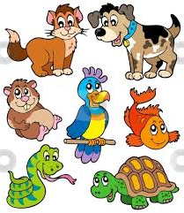
Las Mascotas (las mas-coat-as)
Notes:
4

Slide 5
Un perro (oon perrr-oh)
Notes:
5
5

Slide 6
Un gato (oon gat-oh)
Notes:
6
6

Slide 7
Un hámster (oon aamster)
Don’t forget to raise your voice on the letter with the accent;á
Notes:
7
7

Slide 8
Un pez (oon peth)
Notes:
8
8

Slide 9
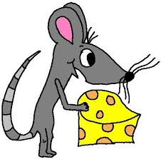
Un ratón (oon raat-on)
Don’t forget to raise your voice on the letter with the accent; ó
Notes:
9
9

Slide 10
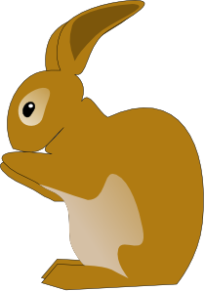
Un conejo (oon kon-eh-co)
Notes:
10
10

Slide 11

Un cuy/una cobaya
(oon kwee) (oon kob-eye-a)
Notes:
11

Slide 12
Un pájaro (oon pa-ka-row)
Don’t forget to raise your voice on the letter with the accent; á
Notes:
12
12

Slide 13
Una Tortuga(oona tort-oo-ga)
Notes:
13
13

Slide 14
Una araña (oona ar-an-ya-o)
The squiggly line on the ñ is called a TILDE.
Notes:
14
14

Slide 15

Instructions for slides 16 &17
Use the power point in slide show mode .
Grab a pen and piece of paper.
Can you guess what the words mean as they appear?
The answers are on slide 17

Slide 16
¿Las recordáis? Can you remember them?
ratón
pájaro
perro
hámster
tortuga
araña
conejo
cuy/cbaya
gato
pez
Las mascotas
Notes:
16

Slide 17
¿Las recordáis?
mouse
bird
dog
hamster
tortoise
spider
rabbit
guinea-pig
gato
pez
Pets
Notes:
17

Slide 18
Instructions for slide 19
On the next slide, you are going to learn how to say ¿Qué mascota tienes en casa? “What pet do you have at home?”
Can you make a sentence in Spanish? For example; En casa tengo un perro.At home, I have a dog. If you have more than one, include the number and add an s to the pet, to make it plural. For example; En casa tengo dos perros.
You may need to use the co-ordinating conjunction y (and) if you have different kinds of pets. For example; En casa tengo dos perros y un gato. At home, I have 2 dogs and a cat.

Slide 19
¿Qué mascota tienes en casa?
En casa, tengo ……….
At home, I have …………
No tengo mascota.
I don’t have a pet.
(If you don’t have a pet, make a sentence with the pet(s) that you would like to have)
Un perro
Un gato
Un pez
Un conejo
Un pajáro
Un hámster
Un cuy
Un ratón
Una tortuga
Una araña

Slide 20
Instructions for slides 21-30
Can you guess the pet in Spanish, before they appear?

Slide 21
Un perro (oon perrr-oh)
Notes:
21
21

Slide 22
Un gato (oon gat-oh)
Notes:
22
22

Slide 23
Un hámster (oon aamster)
Notes:
23
23

Slide 24
Un pez (oon peth)
Notes:
24
24

Slide 25
Un ratón (oon raat-on)
Notes:
25
25

Slide 26
Un conejo (oon kon-eh-co)
Notes:
26
26

Slide 27
Un cuy/una cobaya
(oon kwee) (oon kob-eye-a)
Notes:
27

Slide 28
Un pájaro (oon pa-ka-row)
Notes:
28
28

Slide 29
Una Tortuga(oona tort-oo-ga)
Notes:
29
29

Slide 30
Una araña(oona ar-an-ya-o)
Notes:
30
30

Slide 31

Take a break!
On the next 2 slides, there are 2 videos. They will help you learn how to say the words for the pets correctly. As you hear the words, repeat them.
You will hear the words for 2 new pets.
Try and remember them, if you can!

Slide 32

Video 1

Slide 33

Video 2

Slide 34
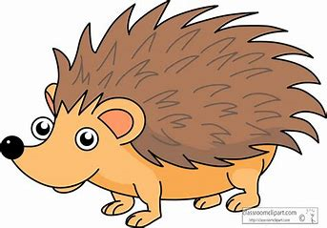
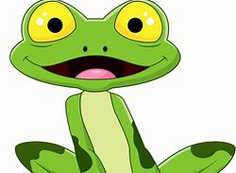
Can you remember the words for…?
Eriso or Erizo?
Rona or Rana?

Slide 35
Did you guess correctly?
Erizo Rana

Slide 36
This activity sheet comes in three parts:
Try to find the 10 pets in the word search in Spanish, and circle them. There is also another word associated with pets. Can you find it? The clue is in the title?????
Colour in the pets.
3. Finish off the sentence; En casa tengo…
Look back at slide 19,if you can’t remember what it means.
The answers are on slide 37.
Don’t forget to write the date in Spanish at the top. Use slides 38 to help you.

Slide 37
Answers
The extra word was …
Mascotas!

Slide 38
Activity Sheet Help
When you are writing the date, choose the correct day and month:
lunes
martes
miércoles
jueves
viernes
sábado
domingo
Remember:DAYS OF THE WEEK AND MONTHS OF THE YEAR DO NOT START WITH CAPITALS IN SPANISH!!!!!!
enero
febrero
marzo
abril
mayo
junio
julio
agosto
septiembre
octubre
noviembre
diciembre
© 27.05.20 L. Interian

Slide 39

¡Hasta la próxima lección!
See you soon for the next lesson!
¡Cuidaos! – Take Care!
Señora Interian
© 01.07.20 L. Interian

