Slide 1
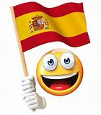
¡Bienvenidos a nuestra lección de español!
Hola Y6 and welcome to our Spanish lesson!
Don’t forget to use “Linguascope” to help you go over/learn new vocabulary (words)
The next slide will show you how to log on to Linguascope.

Slide 2

Linguascope log on
Search for https://www.linguascope.com
Click on Log in
Username = stcats
Password = langs4life
Click on Let’s go
Click on Beginner
Click on Yellow and red flag
Click on one of the new topics, or go over a topic that we have already learnt. All of the topics are very useful for High School, so just choose the ones you are interested in.
Click on Introducción & then practise the words.
Click on ¡Escucha! and do this exercise to see if you’re ready for the games.
Play the games.
If you have a printer at home, you could print the worksheet by clicking on Imprime una ficha.

Slide 3
La lección para esta semana. Lesson for this week!
In this week’s Spanish lesson, we are going to learn how to form adjectives ending in 0.It’s quite tricky.Don’t worry if you don’t understand all the rules, you will learn them more thoroughly in Y7,
Before we start today’s lesson we are going to do some revision of the present tense.
Don’t forget to use the power point in slide show mode. The lesson will work better that way.

Slide 4
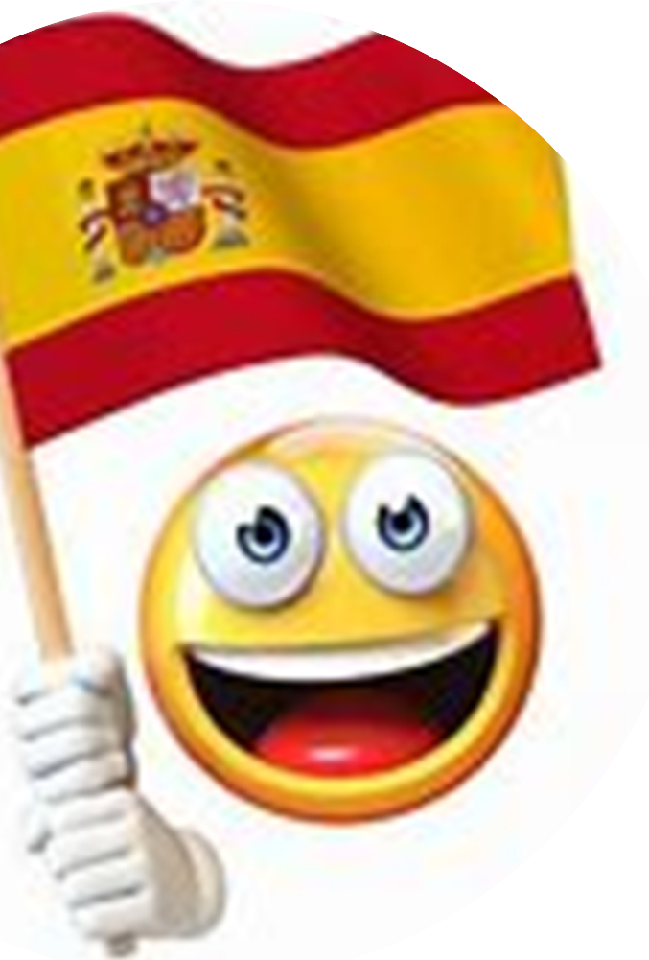
Replace the ? with the correct ending. Write your answers down, so you can check them on the next slide.
Regular Present Tense Endings
AR ER IR
Yo Hablo Como Viv?
Tú Habl? Com? Vives
Él /ella Habla Com? Vive
Nosotros Hablamos Com? Viv?
Vosotros Habl? Coméis Viv?
Ellos/ellas Habl? Comen Viven

Slide 5

How many did you get right?
Regular Present Tense Endings
AR ER IR
Hablo Como Vivo
Hablas Comes Vives
Habla Come Vive
Hablamos Comemos Vivimos
Habláis Coméis Vivís
Hablan Comen Viven

Slide 6

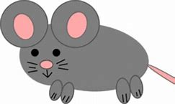

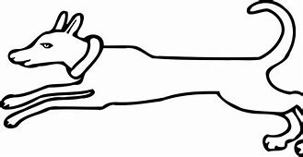
Before we look at Spanish adjectives, try to remember that the adjective comes after the noun in Spanish?
The white dog in Spanish would be…
El perro blanco
(The dog white)
The black chair in Spanish would be…
La silla negra
(The chair black)
The small mouse in Spanish would be…
El ratón pequeño
(The mouse small)

Slide 7
We also need to know…
…if a noun (person, place or thing) is masculine or feminine and singular or plural.
Masculine singular nouns start with … | Feminine singular nouns start with … | Masculine plural nouns start with … | Feminine plural nouns start with …
Un (a) | Una (a) | Unos (some) | Unas (some)
El (the) | La (the) | Los (the) | Las (the)

Slide 8
Can you remember what they mean in English? (The answers are on the next slide)
Choose from the English words under the table. Don’t forget in Spanish there are two words for a, two words for some and four words for the!!
Masculine singular nouns start with … | Feminine singular nouns start with … | Masculine plural nouns start with … | Feminine plural nouns start with …
un | una | unos | unas
el | la | los | las
The (singular) A Some The (plural)

Slide 9
How did you do?
Answers
Masculine singular nouns start with … | Feminine singular nouns start with … | Masculine plural nouns start with … | Feminine plural nouns start with …
un = a | una = a | unos = some | unas = some
el = the | la = the | los = the | las = the

Slide 10
Spanish Adjectives
Adjectives agree with the noun they describe. This means that the ending depends on whether the noun is masculine or feminine, singular or plural. Look at the pattern below using the adjective rojo (red):
Adjective ends in O | Masculine singular | Feminine singular | Masculine plural | Feminine plural
rojo | rojo | roja | rojos | rojas
Don’t forget that in Spanish adjectives come AFTER the noun. Let’s look at some examples on the next slide.

Slide 11
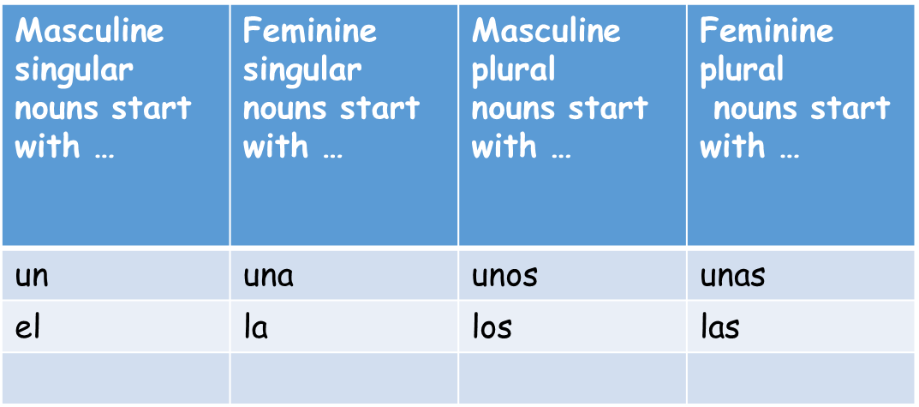

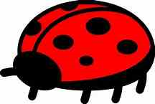
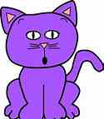

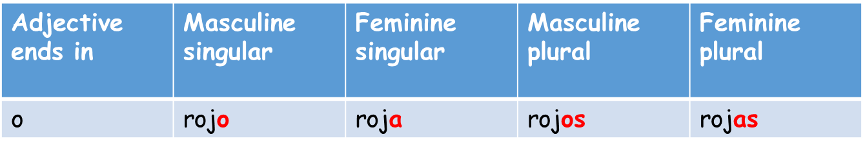


What are the correct endings on the adjectives?
Use the tables on the left to help you.
Un balón amarill__
2. Una mariquita roj__
3. Unos gatos morad___
4. Unas cámaras negr___

Slide 12
Answers- Respuestas
Un balón amarillO
(a yellow ball)
Una mariquita rojA
(a red ladybird )
3. Unos gatos moradOS
(some purple cats )
Unas cámaras negrAS
(some black camaras )

Slide 13

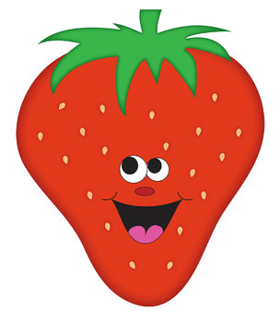
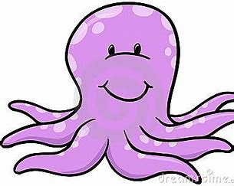
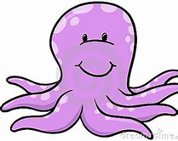


What are the correct endings on the adjectives?
Use the tables on the left to help you.
El pato amarill__
2. La fresa roj__
3. Los pulpos morad___
4. Las teles negr___

Slide 14
Answers- Respuestas
El pato amarillO
(the yellow duck)
La fresa rojA
(the red strawberry)
3. Los pulpos moradOS
(the purple octopuses)
Las teles negrAS
(the black teles)

Slide 15
It’s time for the activity sheet.
Slide 15 will help you with the fecha. (date)
Put the correct endings on the adjectives. Use slide 16 to help you decide on the correct endings.
The answers are on slide 17.
When you’ve finished you can colour in the activity sheet.
© 10.06.20 L. Interian

Slide 16
Activity Sheet Help
When you are writing the date, choose the correct day and month:
lunes
martes
miércoles
jueves
viernes
sábado
domingo
Remember:DAYS OF THE WEEK AND MONTHS OF THE YEAR DO NOT START WITH CAPITALS IN SPANISH!!!!!!
enero
febrero
marzo
abril
mayo
junio
julio
agosto
septiembre
octubre
noviembre
diciembre

Slide 17
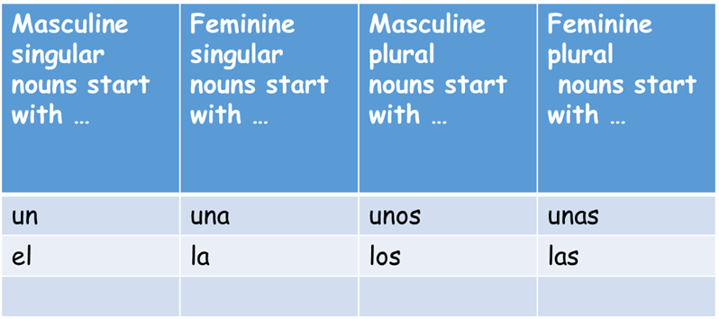
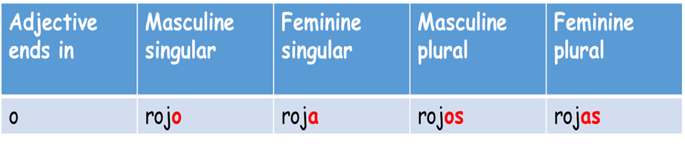
Activity Sheet Help
Choose from the following endings:
As
O
Os
A

Slide 18

Answers to the activity sheet

Slide 19

¡Hasta la próxima lección!
See you soon for the next lesson!
¡Cuidaos! – Take Care!
Señora Interian
Don’t forget, if you can’t remember these rules for adjectives ending in O, you will learn them more thoroughly in Y7
© 03.07.20 L. Interian

